Slide 1

CAPSTONE PROJECT
SmartChef AI – Recipe Preparation Agent
Presented By:
1. SANYA GAUTAM- JIMSEMTEC- BTech CSE

Slide 2
OUTLINE
Problem Statement
Proposed System/Solution
System Development Approach
Algorithm & Deployment
Result
Conclusion
Future Scope
References

Slide 3
Problem Statement
Problem Statement No. 16- Recipe Preparation Agent
The Challenge - A Recipe Preparation Agent helps users cook meals using only the ingredients they have on hand.
By inputting available groceries, users receive tailored recipe suggestions using a RAG-based AI system. The agent retrieves relevant recipes and generates step-by-step instructions adapted to ingredient limitations.
It offers substitutions, cooking tips, and dietary adjustments based on user preferences or restrictions.Designed to reduce food waste and save time, it turns pantry items into practical meal solutions.
This AI assistant makes everyday cooking smarter, simpler, and more sustainable.

Slide 4
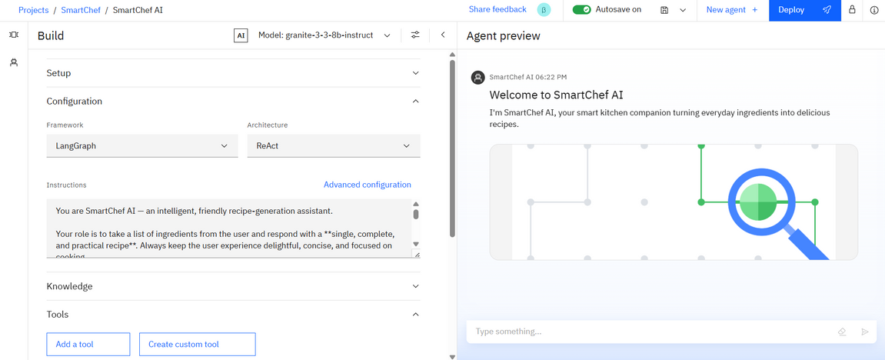
Proposed Solution
SmartChef AI is an AI-powered virtual cooking assistant that:
Accepts user’s available ingredients as input
Suggests tailored recipes using a Retrieval-Augmented Generation (RAG) model
Guides users through each step interactively
Suggests alternative ingredients when something is missing
Adjusts cooking instructions based on preferences (e.g., vegan, low-salt)

Slide 5
System Approach
Platform: IBM Cloud Lite Services + IBM Watson Assistant + Agentic AI Framework
Technologies:
IBM Granite foundation model for language understanding
RAG pipeline for fetching relevant recipes
IBM Cloud Deployment Space for hosting & integrating the agent
Data Sources: Recipes, cuisines, meals and
countries

Slide 6
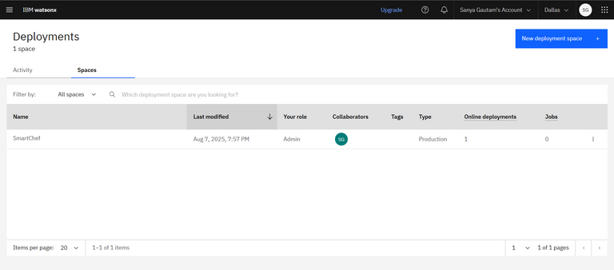
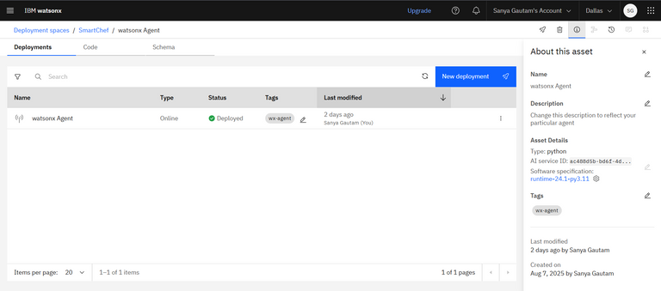
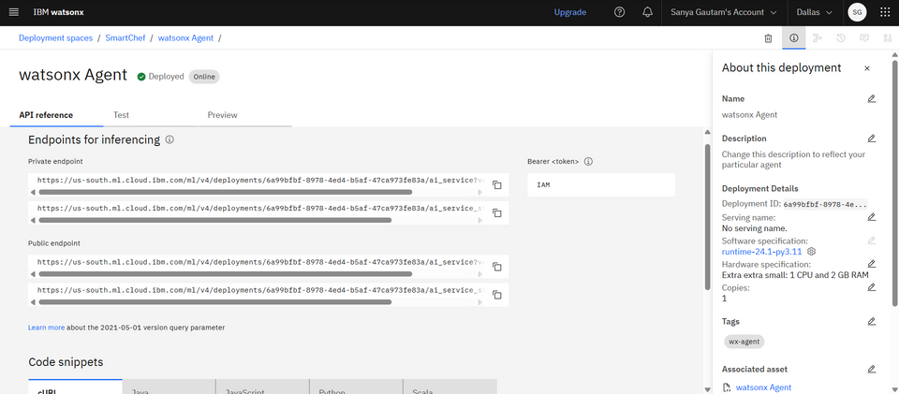
Algorithm & Deployment
Algorithm Flow:
1. User Input: Ingredients list provided by user
2. Recipe Retrieval: RAG model searches for recipes using available ingredients
3. Ingredient Validation: Missing ingredients flagged → substitutions suggested
4. Interactive Cooking: Step-by-step guidance provided
5. Follow-up Queries: Natural language queries answered during cooking
Deployment Process:
Create deployment space in IBM Cloud
Select IBM Granite model and configure
Deploy
Test API endpoints
1.
2.
3.
4.

Slide 7
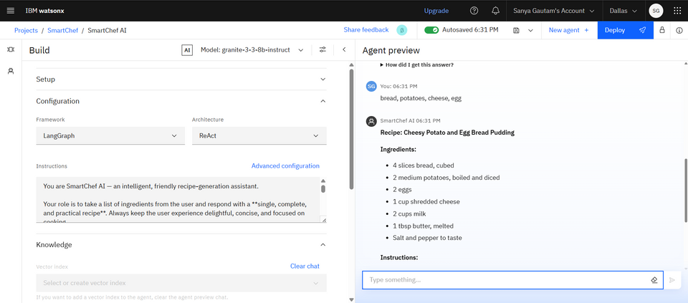
Result
Example User Interaction:
User: "bread, potatoes, cheese, egg"
SmartChef AI:
Retrieved recipe "Cheesy Potato and Egg Bread Pudding"
Listed exact ingredient quantities
Provided clear, step-by-step cooking instructions
Key Outputs:
Generates recipe tailored to available ingredients
Includes precise measurements and cooking steps
Offers a complete, ready-to-cook solution instantly

Slide 8
Conclusion
SmartChef AI makes cooking:
Faster - no need to search multiple sites
Smarter - adapts recipes to what’s on hand
More sustainable - reduces food waste
More beginner-friendly - step-by-step guidance ensures success

Slide 9
Future scope
Voice-only cooking mode for hands-free operation
Integration with smart kitchen appliances
Multi-language recipe support
Nutrition tracking & meal planning
Automatic pantry tracking via barcode scannin

Slide 10
References
IBM Watson Assistant Documentation
IBM Granite Model Guides
Recipe datasets & culinary substitution resources

Slide 11
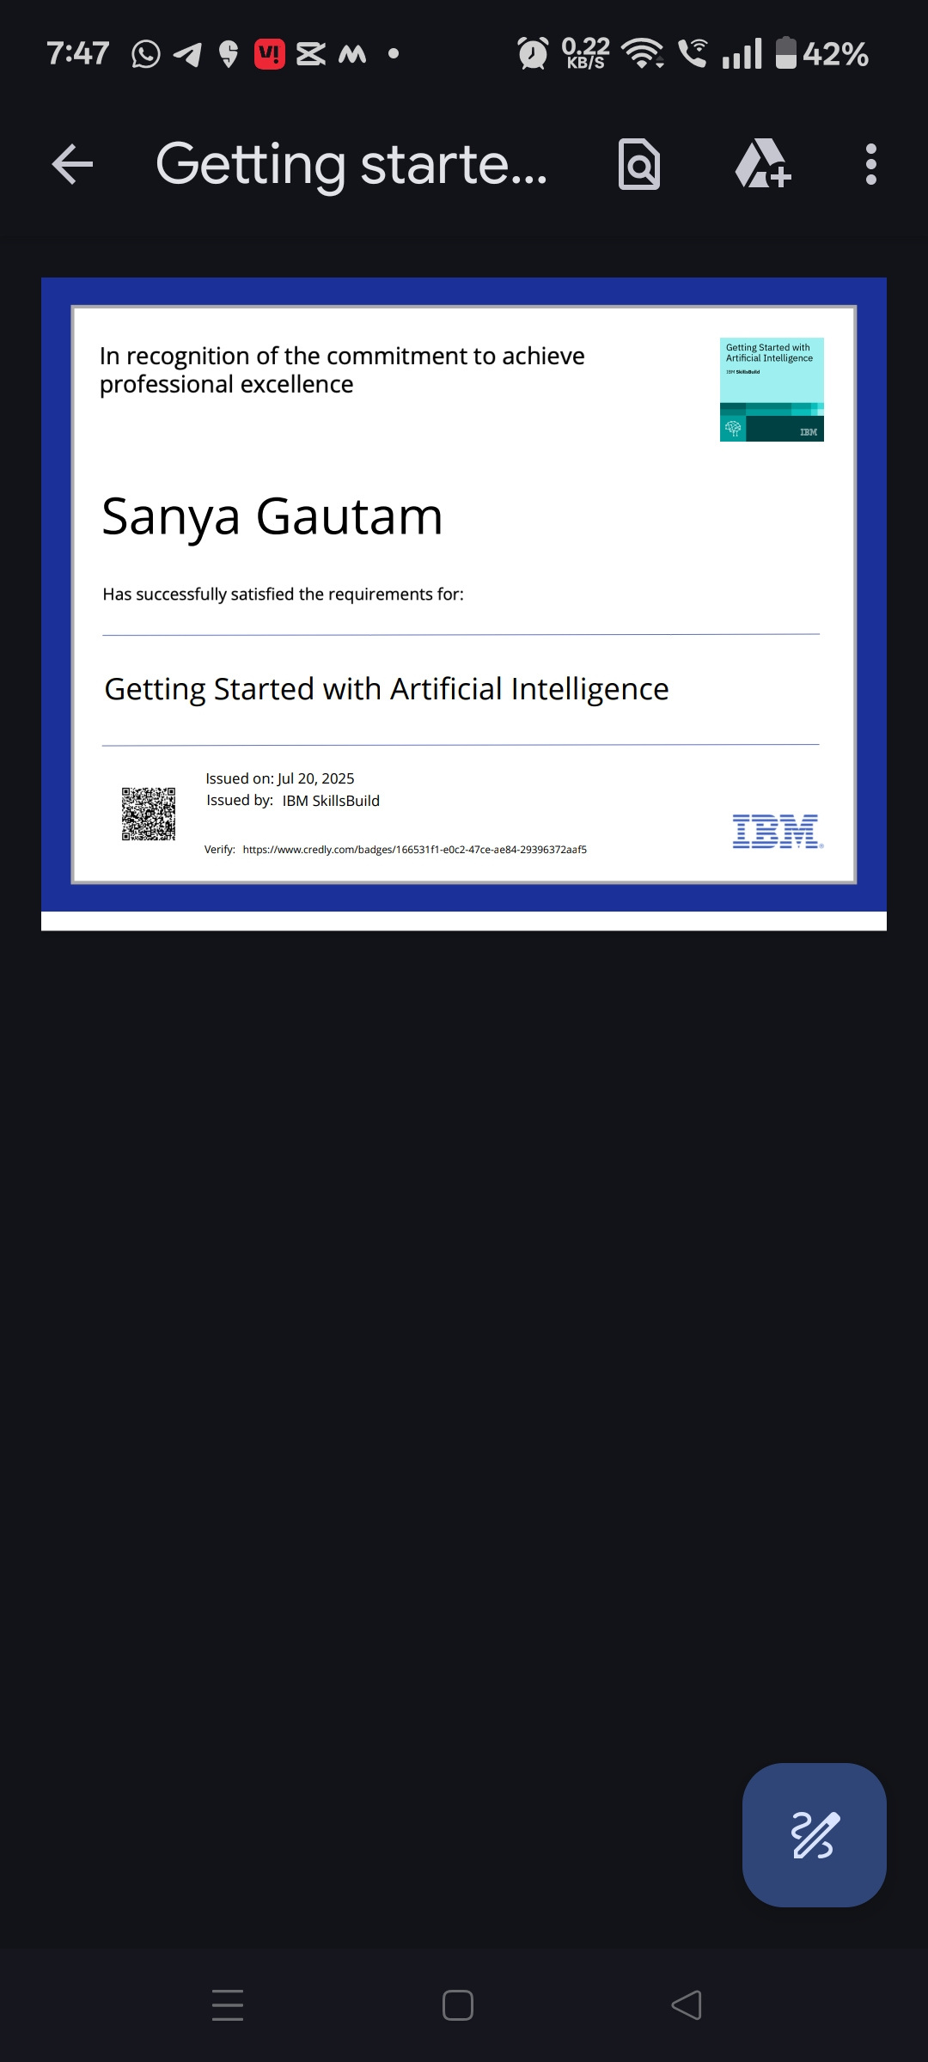
IBM Certifications
credly certificate( getting started with AI)

Slide 12
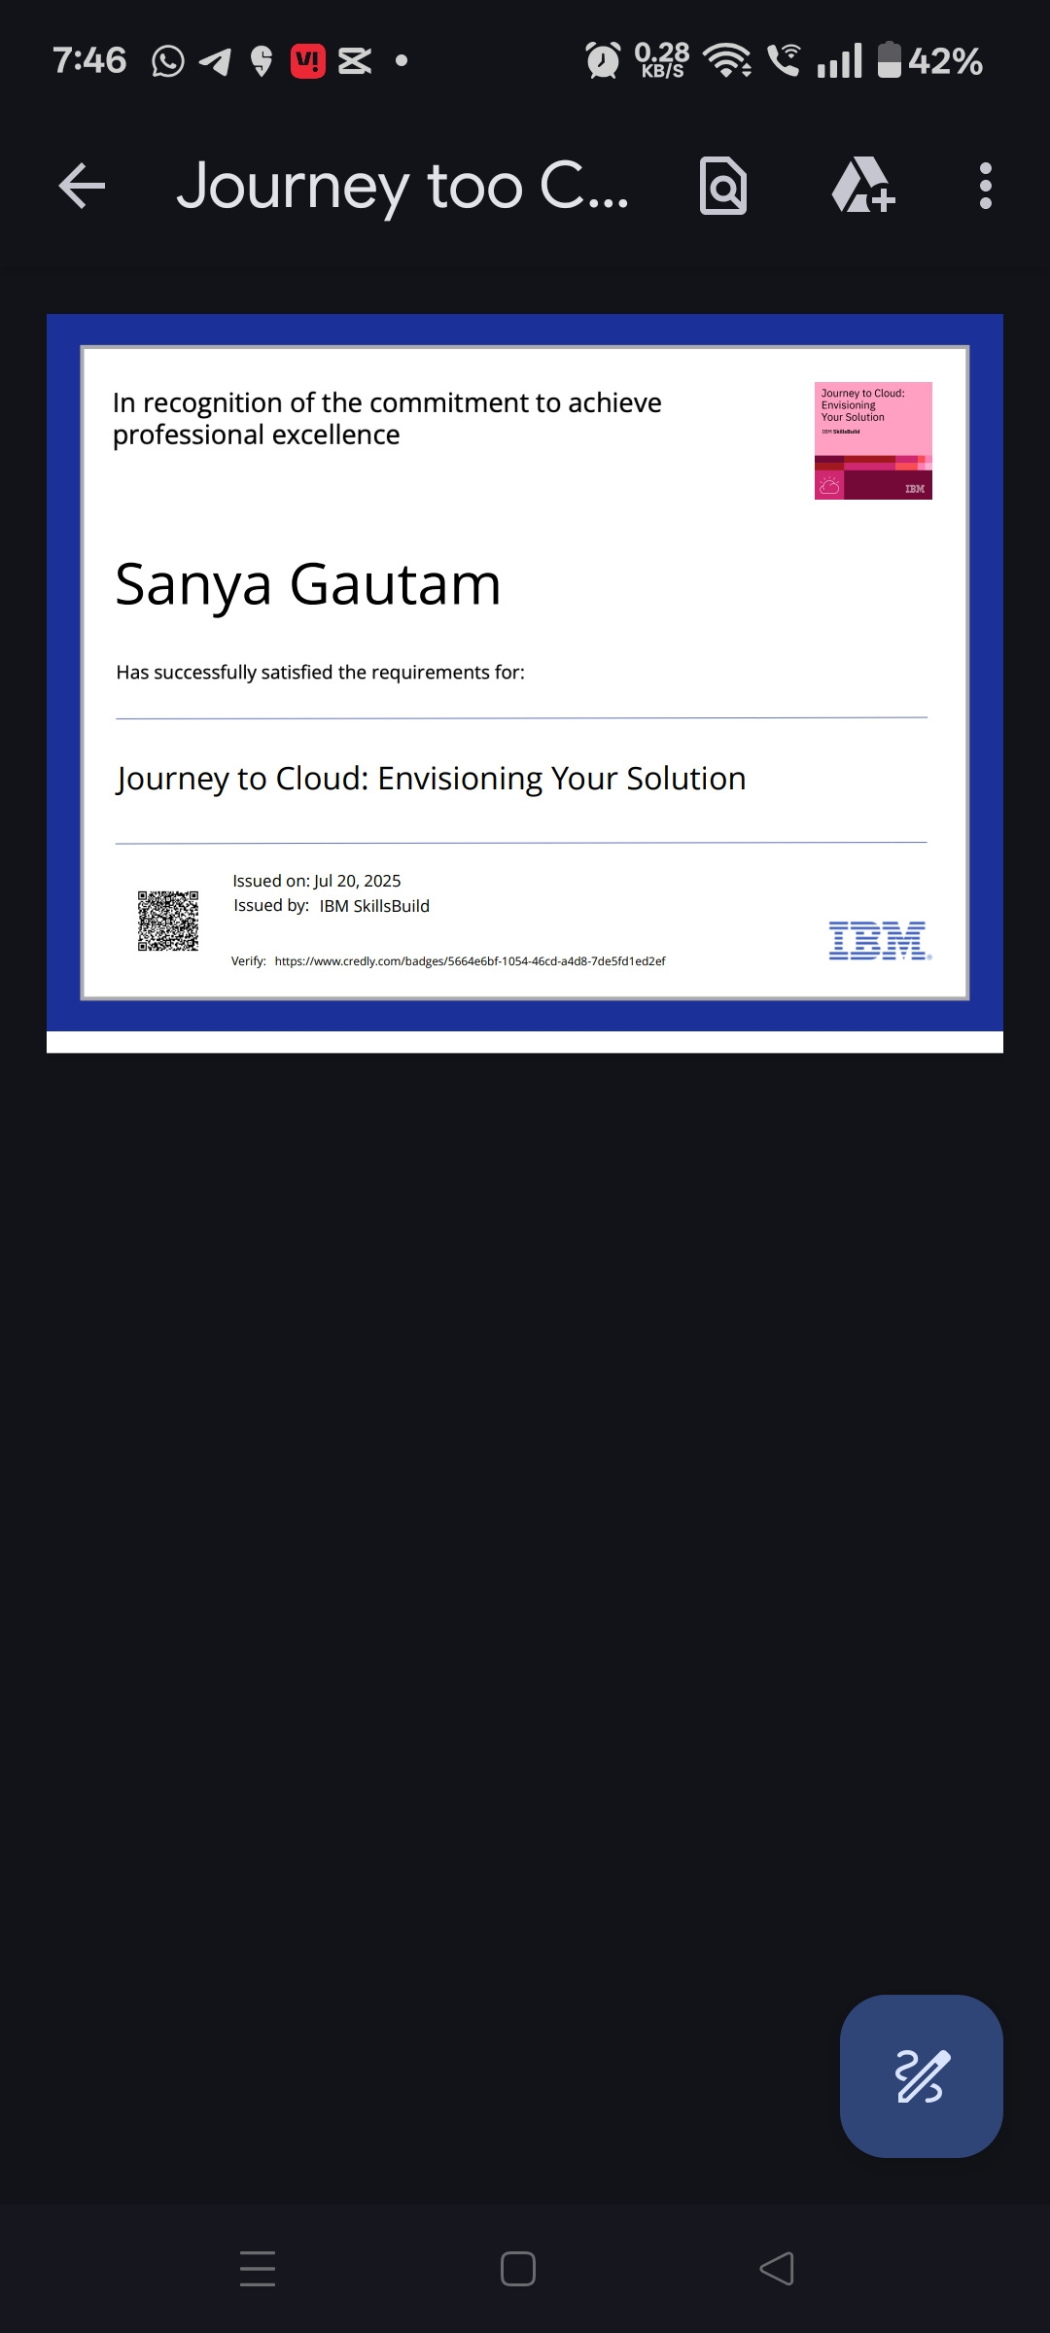
IBM Certifications
credly certificate( Journey to Cloud)

Slide 13
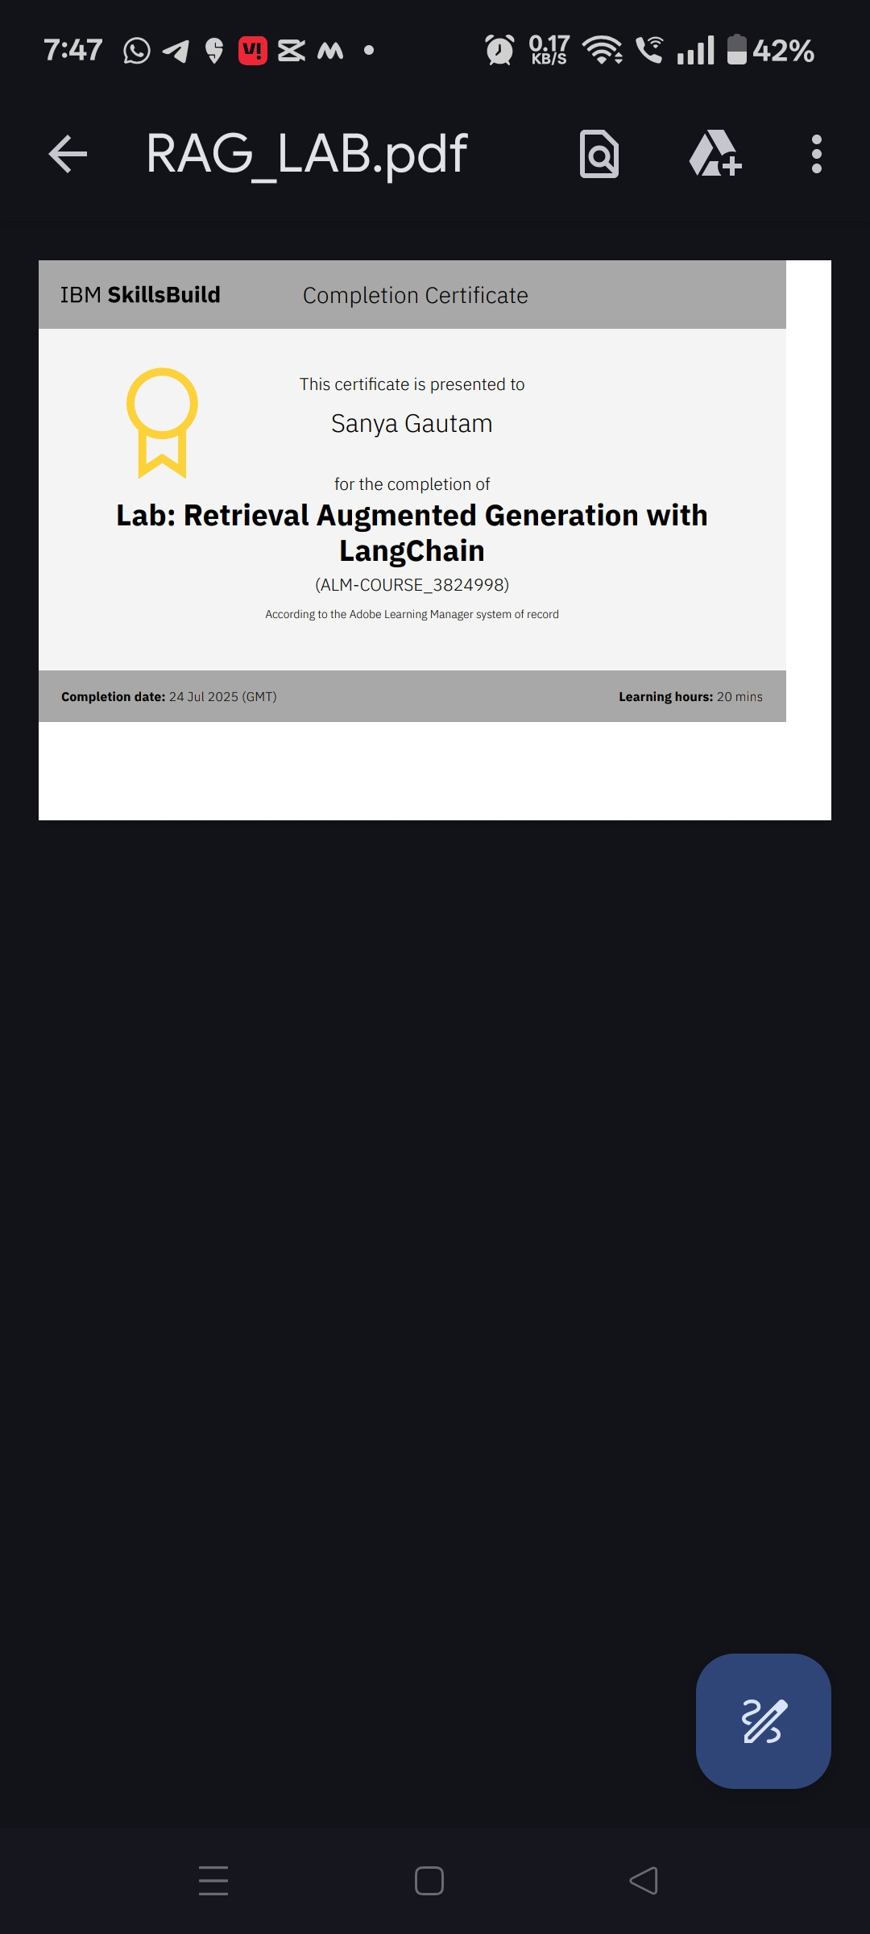
IBM Certifications
Credly certificate( RAG Lab)

Slide 14
GITHUB REPOSITORY LINK
Github Repo link

Slide 15
THANK YOU

